Slide 1


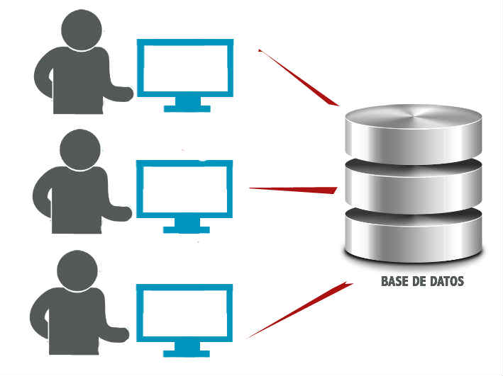
Universidad Nacional Autónoma de Honduras Carrera de Ingeniería en Sistemas
IS-501 Base de Datos I
SQL
DML

Slide 2
SQL - DML
Fecha Actual:
ORACLE: SYSDATE SELECT SYSDATE FROM DUAL;
MYSQL: CURDATE() SELECT CURDATE()
SQLSERVER: GETDATE() SELECT GETDATE()
POSTGRESQL: CURRENT_DATE SELECT CURRENT_DATE

Slide 3
SQL - DML
datepart | Abbreviations
year | yy, yyyy
quarter | qq, q
month | mm, m
dayofyear | dy, y
day | dd, d
week | wk, ww
weekday | dw
hour | hh
minute | mi, n
second | ss, s
millisecond | ms
microsecond | mcs
nanosecond | ns
Manejo de Fecha SQL Server
DATEPART ( datepart , date )
https://docs.microsoft.com/en-us/
sql/t-sql/functions/datepart-transact-sql

Slide 4
SQL - DML
Oracle , MySQL, Postgresql
EXTRACT(part FROM date);
Part: Year, Month, day

